Slide 1

Computer Networks LAB 1
Linux overview and Installation of Linux (Ubuntu)
Instructor
Farwa Ahmad
Notes:
‹#›

Slide 2
Outline
Basic Commands
Relative & Absolute Path
Redirect, Append and Pipe
Permission
Process Management
Notes:
‹#›
First, I’m gonna go through Unix System.

Slide 3
BASIC COMMANDS
How to run commands
Search—Type Terminal
Press Ctrl+Alt+t to open Terminal
When you will open Terminal, you will see,
[someone]$
One command consists of three parts, i.e. command name, options, arguments.
Example)‏
[someone~]$ command-name optionA optionB argument1 argument2

Slide 4
BASIC COMMANDS
How to run commands
Between command name, options and arguments, space is necessary.
Options always start with “-”
Example:
cd ..
ls –l .bashrc (A file that determines the behaviour of interactive shells)
mv fileA fileB

Slide 5
BASIC COMMANDS
Commands
ls show files in current position
cd change directory
cp copy file or directory
mv move file or directory
rm remove file or directory
pwd show current directory
mkdir create directory
rmdir remove directory
less, more, cat display file contents
man command read the online manual page for a command
whatis give brief description of a command
Notes:
‹#›
“ls” stands for list.
Pwd stands for present working directory

Slide 6
BASIC COMMANDS
Commands
su switch user (su ,sudo su)
passwd change password
adduser create new user account
sudo adduser username
sudo su username (to check the created user)
userdel delete user account
df show disk space usage
shutdown reboot or turn off machine
sudo shutdown now
Notes:
‹#›
“su” means switch user. When you have several user account on one machine.

Slide 7
BASIC COMMANDS
Commands
Touch filename create new file
:>filename create new file
:>>filename create new file
userdel delete user account
df show disk space usage
shutdown reboot or turn off machine
sudo shutdown now
Notes:
‹#›
“su” means switch user. When you have several user account on one machine.

Slide 8
Relative and Absolute path
Absolute path
An absolute path is defined as specifying the location of a file or directory from the root directory(/).
In other words, we can say that an absolute path is a complete path from start of actual file system from / directory.
For example: $cat abc.sql
will work only if the fie “abc.sql” exists in your current directory. However, if this file is not present in your working directory and is present somewhere else say in /home/kt , then this command will work only if you will use it like shown below:
$cat /home/kt/abc.sql

Slide 9
Relative and Absolute path
Absolute path
Address from the root
/home/linux/
~/linux
Similar to:
FAST National University/ Chiniot-FSD Campus/ CS Department/ 2015 Batch/ Section A

Slide 10
Relative path
is defined as the path related to the present working directly (pwd). It starts at your current directory and never starts with a / .
To be more specific, if we are looking for photos then absolute path for it will be provided as
/home/jono/photos
but assuming that we are already present in jono directory then the relative path for the same can be written as simple
photos.

Slide 11
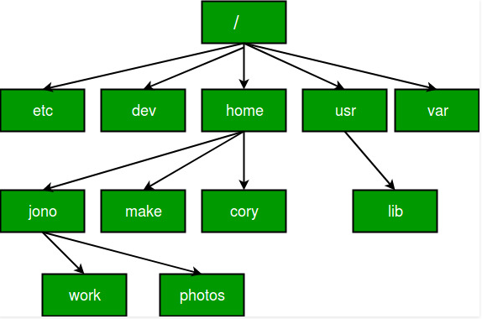

Slide 12
Relative path
Relative to your current location
“.” your current location
“..” one directory above your current location
“pwd” (print working directory )gives you your current location
Example
ls ./linux : lists the content of the dir linux
ls ../../ : lists everything that is two dir higher
Similar to:
Go Left/turn right/take the TSOL/go

Slide 13
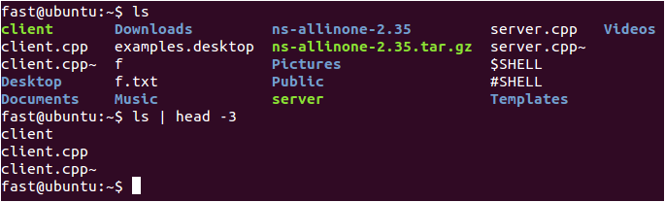
Redirect, append and pipe
Redirect and append
Output of command is displayed on screen.
Using “>”, you can redirect the output from screen to a file.
Using “>>” you can append the output at the end of the file.
Pipe
Some commands require input from a file or other commands (a mechanism for sending data from one program to another).
Using “|”, you can use output from other command as input to the command.

Slide 14
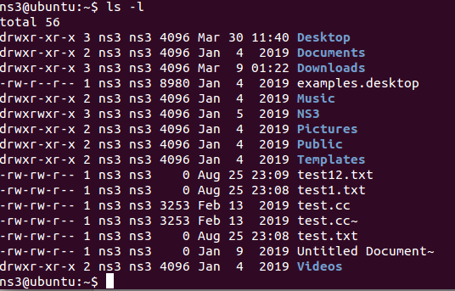
PERMISSION
All of files and directories have owner and permission.
There are three types of permission, readable, writeable and executable.
Permissions are given to three kinds of groups. owner, group member and others.
r🡪readable, w🡪writable, x🡪executable
Example:
Notes:
‹#›

Slide 15
Example:
In the above example the first 10 characters of the output are what we look at to identify permissions.
The first character identifies the file type. If it is a dash ( - ) then it is a normal file. If it is a d then it is a directory.
The following 3 characters represent the permissions for the owner.
A letter represents the presence of a permission and a dash ( - ) represents the absence of a permission. In this example the first file owner has all permissions (read, write but not execute).
The following 3 characters represent the permissions for the group. In this example the group has the ability to read but not write or execute.
Note that the order of permissions is always read, then write then execute.
Finally the last 3 characters represent the permissions for others (or everyone else). In this example they have the read permission and nothing else.
Notes:
‹#›

Slide 16
PERMISSION
Chmod 456 test.txt
Command
chmod change file mode, add or remove permission
chown change owner of the file
Example)‏
chmod a+w filename
add writable permission to all users
chmod o-x filename
remove executable permission from others
chmod a+x
Gives permission to the user to execute a file
u🡪user (owner), g🡪group, o🡪others a🡪all
Chown –R USERNAME:GROUPNAME /PATH/TO/FILE

Slide 17
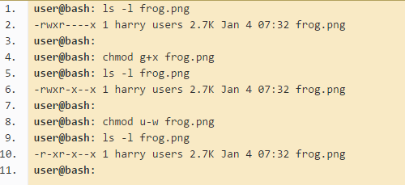
PERMISSION
Grant the execute permission to the group.
Then remove the write permission for the owner.

Slide 18
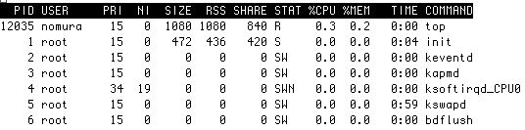
PROCESS MANAGEMENT
Process is a unit of running program.
Each process has some information, like process ID, owner, priority, etc.
Example) Output of “top” command

Slide 19
Some more commands
sudo apt-get update
The above command will execute command and the operating system will update
sudo apt-get install {package-name}
This command will install packages with the root privileges.
sudo apt-get remove {package-name}
This command will remove packages with the root privileges.
sudo apt-get update {package-name}
This command will update packages with the root privileges.

Slide 20
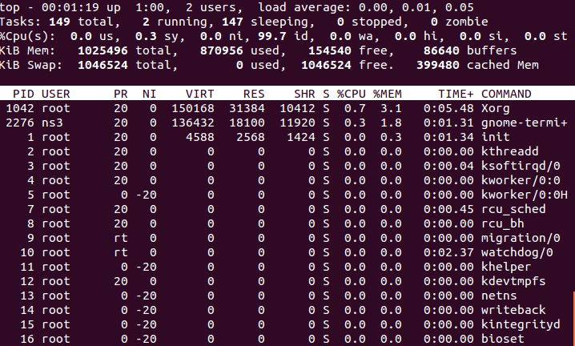
PROCESS MANAGEMENT
Line 1-2 Tasks is just another name for processes. It's typical to have quite a few processes running on your system at any given time. Most of them will be system processes. Many of them will typically be sleeping. This is ok. It just means they are waiting until a particular event occurs, which they will then act upon.
Notes:
‹#›
These are commands related with process management. Kill is used to stop your program.

Slide 21
PROCESS MANAGEMENT
Line 3 CPU information.
Line 4 This is a breakdown of working memory (RAM). Don't worry if a large amount of your memory is used. Linux keeps recently used programs in memory to speed up performance if they are run again. If another process needs that memory, they can easily be cleared to accommodate this.
Line 5 This is a breakdown of Virtual memory on your system. If a large amount of this is in use, you may want to consider increasing it's size. For most people with most modern systems having gigabytes of RAM you shouldn't experience any issues here.
Lines 6 - --- Finally is a listing of the most resource intensive processes
Notes:
‹#›
These are commands related with process management. Kill is used to stop your program.

Slide 22
PROCESS MANAGEMENT
Commands
kill Stops a program. The program is specified by process ID.
killall Stops a program. The program is specified by command name.
ps Shows process status
top Shows system usage statistics
Notes:
‹#›
These are commands related with process management. Kill is used to stop your program.

Slide 23
Common Text Editors for Ubuntu
GUI Text Ediotors:
Gedit gedit /path/to.file.txt
Kate kate /path/to.file.txt
Leafpad leafpad /path/to.file.txt
Mousepad mousepad /path/to.file.txt
Pluma pulma /path/to.file.txt
CLI Text Editors:
Nano nano /path/to.file.txt
Vim vim or vi /path/to.file.txt
Sublime, atom, geany and many more.
Notes:
‹#›
R: 1
W: 2
X: 4
Chmod o+x file.txt
File.txt: r-x (o)
rw- r-- r-x
1+2+0 1+0+0 1+0+4
1 5
315
Chmod 315 file.txt

